Slide 1
Python and scikit-learn
Topics relevant to Machine Learning
Dr. U. Michelucci
(with slides from M. Sperti, POLITO)
© Dr. U. Michelucci – umberto.Michelucci@hslu.ch

Slide 2
Learning Goals
The students know the tools used in machine learning projects and their advantages and disadvantages
The studends understands the fundamental concepts of GitHub
The students understand the main components of a machine learning pipeline
The students can explain the main advantages of numpy with respect to plain Python
The students understand the importance of avoiding over-engineering
The students know the best practices of coding
The students know what scikit-learn is and its role for machine learning projects
© Dr. U. Michelucci – umberto.Michelucci@hslu.ch

Slide 3
Skills for a machine learning project
Linear Algebra, Calculus
Programming
Statistics
Engineering
© Dr. U. Michelucci – umberto.Michelucci@hslu.ch

Slide 4
Reproducibility and Replicability (two opposite definitions)
“Reproducibility” refers to instances in which the original researcher's data and computer codes are used to regenerate the results, while “replicability” refers to instances in which a researcher collects new data to arrive at the same scientific findings as a previous study.
“Reproducibility” refers to independent researchers arriving at the same results using the original data and methods, while “replicability” refers to a different team arriving at the same results using their own artifacts.
National Academies of Sciences, Engineering, and Medicine. "Reproducibility and replicability in science." (2019).
© Dr. U. Michelucci – umberto.Michelucci@hslu.ch

Slide 5
Reproducibility and Replicability (two opposite definitions)
“Reproducibility” refers to instances in which the original researcher's data and computer codes are used to regenerate the results, while “replicability” refers to instances in which a researcher collects new data to arrive at the same scientific findings as a previous study.
National Academies of Sciences, Engineering, and Medicine. "Reproducibility and replicability in science." (2019).
© Dr. U. Michelucci – umberto.Michelucci@hslu.ch

Slide 6
Reproducibility in Machine Learning
Machine Learning View of reproducibility
By using the same dataset, and following the same steps other researchers must be able to obtain the “same” trained model that has the “same” performance by starting from scratch.
TL;DR (Too Long; Didn’t Read – Internet Slang)
Someone else must be able to get the same results you got.
© Dr. U. Michelucci – umberto.Michelucci@hslu.ch

Slide 7
Your task as scientists
One important task, as scientists, is to make sure that your work is reproducible. If is not, your work is scientifically useless.
In addition your work must be transparent. All the steps must be clear and understandable. Another researcher must be able to re-implement (or understand) everything you did (every single step) from scratch.
© Dr. U. Michelucci – umberto.Michelucci@hslu.ch

Slide 8
Tools and reproducibility
You need to use the right tools, to ensure that your work is reproducible and transparent (and in the right way). This is what we will discuss today.
Other reasons to use specific tools:
Collaboration with multiple people
Exchange of information
Backups of your work
etc.
© Dr. U. Michelucci – umberto.Michelucci@hslu.ch

Slide 9



Tools overview – the fundamental 3
GitHub → code exchange; backup; versioning; make work on code in large teams easy
Python → a great programming language with more scientific computing functions that you will ever need (and a large community)
Jupyter notebooks → A webbased programming environment great for documenting experiments, by mixing text, equations, plots and code
© Dr. U. Michelucci – umberto.Michelucci@hslu.ch

Slide 10
Reproducibility
At the beginning of every research project (especially involving big amounts of data), it is fundamental to clearly organize data, code and documentation inside a unique place
The reason for this is reproducibility
When you perform experiments and analysis on data, you must guarantee that every test you do is reproducible and that, given the same inputs, you always obtain the same outputs
Moreover, this is very useful when you produce research papers, since you must clearly describe the operations you performed on data (in the methods section) and provide lots of figures to prove your findings
© Dr. U. Michelucci – umberto.Michelucci@hslu.ch

Slide 11
GitHub (very) basics
ONLINE
(GitHub.com)
Repository
Ver. 1
Repository
Ver. 2
Repository
Ver. 3
Clone
pull
clone
push
push
commit
Your copy of Repository
commit
Repository w/ modifications
My copy of Repository
Repository w/ modifications
Your Laptop
My Laptop
© Dr. U. Michelucci – umberto.Michelucci@hslu.ch

Slide 12
Whether you’re visualizing data or building a new game, there’s a whole community and set of tools on GitHub that can help you do it even better (1).
GitHub is a development platform, where you can host and review code, manage projects, and build software alongside 50 million developers (2).
GitHub helps you to:
Write better code
Manage a research project
Share code with your team-mates (private repositories) or with the entire GitHub community (public repositories)
https://lab.github.com/
https://github.com/
© Dr. U. Michelucci – umberto.Michelucci@hslu.ch

Slide 13
Basics
Create an account on https://github.com/ (it’s free!)
Create your first repository
Share with your collaborators
If you are a Windows user, download GitHub Desktop app (1)
If you are a Linux user, you don’t need to download anything (you will update your repositories by terminal)
There are four fundamental actions you can perform using GitHub:
Clone a repository
Commit a change inside a repository
Push the committed change to GitHub
Pull an update from GitHub
https://desktop.github.com/
© Dr. U. Michelucci – umberto.Michelucci@hslu.ch

Slide 14
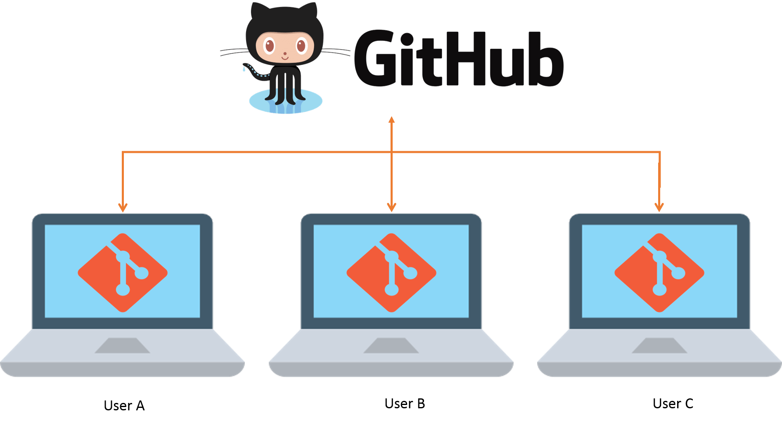
Clone, Commit, Push & Pull
You can create your own repository or open an existing one (e.g. shared with you by one of your team-mates)
Once you have your own repository in GitHub, to use it on your laptop, you must CLONE it (you must perform this step only once, each time you want to use a new repository)
CLONE
© Dr. U. Michelucci – umberto.Michelucci@hslu.ch

Slide 15
Clone, Commit, Push & Pull
Now, you have a new local folder, and you can begin to work on it
When you finish your local work, to update changes and to share changes with other collaborators, you must COMMIT changes and PUSH them to GitHub (you must perform this step every time you have something new to update/share)
CLONE
PUSH
COMMIT
© Dr. U. Michelucci – umberto.Michelucci@hslu.ch

Slide 16
Clone, Commit, Push & Pull
Finally, if you want to update your repository with changes made by other collaborators you must PULL the changes from GitHub (you must perform this step every time you have something new to download)
PULL
CLONE
PUSH
COMMIT
© Dr. U. Michelucci – umberto.Michelucci@hslu.ch

Slide 17
Introduction to
Notebooks
The Jupyter Notebook is an open-source web application that allows you to create and share documents that contain live code, equations, visualizations and narrative text. Uses include data cleaning and transformation, numerical simulation, statistical modeling, data visualization, machine learning, and much more (1)
In TOELT, we use Jupyter Notebooks to write interactive code in Python programming language, but many other languages are supported
To use Jupyter Notebooks you can:
Install Anaconda Navigator (2) and add the Jupyter Notebook application
https://jupyter.org/
https://docs.anaconda.com/anaconda/navigator/
© Dr. U. Michelucci – umberto.Michelucci@hslu.ch

Slide 18

Organize your Code’s Repository
Your work repository should contain:
Data you received (both the raw data and all the data on which you performed cleaning, missing values imputation, normalization, etc.)
Code you wrote to perform every step of your research project (dataset preparation, model development, model validation, results inspection, etc.)
Literature to know the state-of-the-art in the topic you are studying
Paper Preparation Folder to have all the materials you need to prepare a scientific paper in the same place
© Dr. U. Michelucci – umberto.Michelucci@hslu.ch

Slide 19
Machine Learning Pipeline (reminder)
Data Extraction, Load, … (ingest)
Data Preparation
Model Training
Model Deployment
Model Monitor
Model Training
Model Validation
Trained Model
© Dr. U. Michelucci – umberto.Michelucci@hslu.ch

Slide 20
The Repository’s Structure – a suggestion
Model development / training
Code
Data Preparation
Data
Raw Data
Ingest
YourProjectName
Literature
Paper Preparation / results
Code
Data
Model validation
Results
Figures
© Dr. U. Michelucci – umberto.Michelucci@hslu.ch

Slide 21
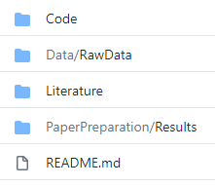

Practical Example: Data Folder
Let’s analyze in more detail the template repository we created. Let’s start from the Data Folder
In this practical example, we will use a toy dataset (the famous Iris Dataset)
Data Folder contains Raw Data Folder, in which we put the data we have, without modifying them
In the readme.md file, you must put a short description of the raw data (number of samples, number of features, number of missing values, etc.)
© Dr. U. Michelucci – umberto.Michelucci@hslu.ch

Slide 22
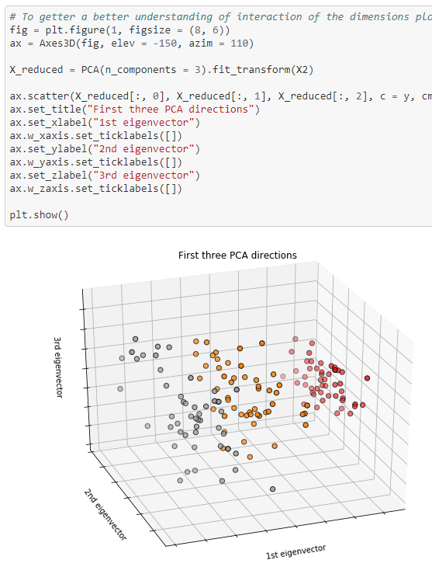
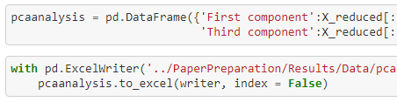
Practical Example: Code Folder
Code folder should contain all code you wrote to perform your experiments on data
To make code reproducible, it is fundamental that you save every data you produce (e.g. every x and y data used to make plots)
For example, on the right, an extract of the code to generate a plot of the three first PCA components of Iris Dataset is shown
Below, an extract of the save section of the PCA data is shown
© Dr. U. Michelucci – umberto.Michelucci@hslu.ch

Slide 23
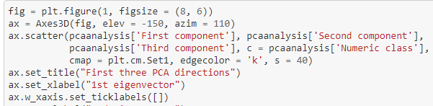


Practical Example:
Paper Preparation Folder
This folder should contain all final data and code you need to reproduce every plot necessary to your paper
It is fundamental that you save each figure (selecting a sufficient resolution) and each data you need to generate that figure
Paper Preparation
Code
Data
Results
Figures
© Dr. U. Michelucci – umberto.Michelucci@hslu.ch

Slide 24
Python Libraries and machine learning pipelines
© Dr. U. Michelucci – umberto.Michelucci@hslu.ch

Slide 25
Machine Learning Pipeline and Python Libraries
Ingest
Prepare
Train
Validate
Deployment
Monitor
Data Extraction, Load, …
Data Preparation
Model Training
Model Deployment
Model Monitor
Model Training
Model Validation
Trained Model
pandas
scikit-learn
scikit-learn
matplotlib
TensorFlow
scipy
numpy
© Dr. U. Michelucci – umberto.Michelucci@hslu.ch

Slide 26
Python
© Dr. U. Michelucci – umberto.Michelucci@hslu.ch

Slide 27
Algorithms and Data Structures
Algorithm
A set of rules or steps used to solve a problem
Data Structure
A particular way of organizing data in a computer
Adapted from www.py4e.com
© Dr. U. Michelucci – umberto.Michelucci@hslu.ch

Slide 28
A List is a Kind of Collection
A collection allows us to put many values in a single “variable”
A collection is nice because we can carry all many values around in one convenient package.
friends = [ 'Joseph', 'Glenn', 'Sally' ]
carryon = [ 'socks', 'shirt', 'perfume' ]
Adapted from www.py4e.com
© Dr. U. Michelucci – umberto.Michelucci@hslu.ch

Slide 29
What is not a “Collection”?
Most of our variables have one value in them - when we put a new value in the variable, the old value is overwritten
$ python
>>> x = 2
>>> x = 4
>>> print(x)
4
Adapted from www.py4e.com
© Dr. U. Michelucci – umberto.Michelucci@hslu.ch

Slide 30
List Constants
>>> print([1, 24, 76])
[1, 24, 76]
>>> print(['red', 'yellow', 'blue'])
['red', 'yellow', 'blue']
>>> print(['red', 24, 98.6])
['red', 24, 98.6]
>>> print([ 1, [5, 6], 7])
[1, [5, 6], 7]
>>> print([])
[]
List constants are surrounded by square brackets and the elements in the list are separated by commas
A list element can be any Python object - even another list
A list can be empty
Adapted from www.py4e.com
© Dr. U. Michelucci – umberto.Michelucci@hslu.ch

Slide 31
Looking Inside Lists
Just like strings, we can get at any single element in a list using an index specified in square brackets
>>> friends = [ 'Joseph', 'Glenn', 'Sally' ]
>>> print(friends[1])
Glenn
Joseph
Glenn
Sally
0
1
2
Adapted from www.py4e.com
© Dr. U. Michelucci – umberto.Michelucci@hslu.ch

Slide 32
Lists can be sliced
>>> t = [9, 41, 12, 3, 74, 15]
>>> t[1:3]
[41,12]
>>> t[:4]
[9, 41, 12, 3]
>>> t[3:]
[3, 74, 15]
>>> t[:]
[9, 41, 12, 3, 74, 15]
Remember: Just like in strings, the second number is “up to but not including”
Adapted from www.py4e.com
© Dr. U. Michelucci – umberto.Michelucci@hslu.ch

Slide 33
A tale of two loops…
friends = ['Joseph', 'Glenn', 'Sally']
for friend in friends :
print('Happy New Year:', friend)
for i in range(len(friends)) :
friend = friends[i]
print('Happy New Year:', friend)
© Dr. U. Michelucci – umberto.Michelucci@hslu.ch

Slide 34
Notes about loops
import random lst1 = random.sample(range(1, 10**8), 10**7) lst2 = random.sample(range(1, 10**8), 10**7)
%%timeit ab = [lst1[i]*lst2[i] for i in range(len(lst1))]
2.06 s ± 326 ms per loop (mean ± std. dev. of 7 runs, 1 loop each)
Challenge: Can you write code that is 80-100 times faster?
© Dr. U. Michelucci – umberto.Michelucci@hslu.ch

Slide 35
Problems with plain Python and lists
Lists does not behave like mathematical objects…
Example:
a = [1, 2, 3, 4]
b = [5, 6, 7, 8]
a+b
>>> [1, 2, 3, 4, 5, 6, 7, 8]
© Dr. U. Michelucci – umberto.Michelucci@hslu.ch

Slide 36

© Dr. U. Michelucci – umberto.Michelucci@hslu.ch

Slide 37
What is numpy (and scipy)
NumPy is a module for Python. The name is an acronym for "Numeric Python" or "Numerical Python” (mostly written in C)
NumPy enriches the programming language Python with powerful data structures, implementing multi-dimensional arrays and matrices.
The implementation is even aiming at huge matrices and arrays, better know under the heading of "big data”
SciPy (Scientific Python) needs Numpy, as it is based on the data structures of Numpy and furthermore its basic creation and manipulation functions. It extends the capabilities of NumPy with further useful functions for minimization, regression, Fourier-transformation and many others.
Source: https://python-course.eu/numerical-programming/introduction-to-numpy.php
© Dr. U. Michelucci – umberto.Michelucci@hslu.ch

Slide 38
Numpy vs. code python
The advantages of Core Python:
high-level number objects: integers, floating point
containers: lists with cheap insertion and append methods, dictionaries with fast lookup
Advantages of using Numpy with Python:
array oriented computing
efficiently implemented multi-dimensional arrays
designed for scientific computation
Source: https://python-course.eu/numerical-programming/introduction-to-numpy.php
© Dr. U. Michelucci – umberto.Michelucci@hslu.ch

Slide 39
Hands-on
© Dr. U. Michelucci – umberto.Michelucci@hslu.ch

Slide 40
Notes about loops with numpy
import random import numpy as np lst1 = random.sample(range(1, 10**8), 10**7) lst2 = random.sample(range(1, 10**8), 10**7) list1_np = np.array(lst1) list2_np = np.array(lst2)
%%timeit out2 = np.multiply(list1_np, list2_np)
20.8 ms ± 2.5 ms per loop (mean ± std. dev. of 7 runs, 10 loops each)
© Dr. U. Michelucci – umberto.Michelucci@hslu.ch

Slide 41
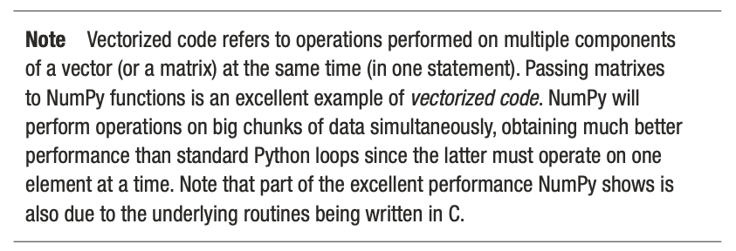
Vectorized Code
© Dr. U. Michelucci – umberto.Michelucci@hslu.ch

Slide 42

Scikit-learn
Machine Learning for Python
© Dr. U. Michelucci – umberto.Michelucci@hslu.ch

Slide 43
An online resource
Nice online course
https://inria.github.io/scikit-learn-mooc/index.html
© Dr. U. Michelucci – umberto.Michelucci@hslu.ch

Slide 44
Advantages of scikit-learn
Scikit-learn covers all parts of a machine learning pipeline (except for neural networks)
Scikit-learn can be integrated and work well with other libraries (as TensorFlow)
Scikit-learn has GREAT documentation that can be used in scientific publications → Example: https://scikit-learn.org/stable/modules/linear_model.html#logistic-regression
© Dr. U. Michelucci – umberto.Michelucci@hslu.ch

Slide 45
Scikit-learn hands-on
© Dr. U. Michelucci – umberto.Michelucci@hslu.ch

Slide 46
Some best practices
Write functions only if you really need to re-use them
Write a piece of code for each experiment you perform. Do not modify existing code and note the results! Each experiments must be reproducible and documented (what happens after 6 months? Will you remember all details? All parameters?)
© Dr. U. Michelucci – umberto.Michelucci@hslu.ch

Slide 47
Related topics remarks
It is important to understand algorithms. Operations, especially in deep learning, are repeated millions of times → thus saving time in each iteration is very important.
Bad programming will have a huge impact on your code in terms of performance and stability.
Over-engineering is always a bad idea. Your code must be as simple as possible and as complex as necessary → it is easy to loos control of what your code does.
© Dr. U. Michelucci – umberto.Michelucci@hslu.ch

Slide 48
Mentioning code in papers
When writing a scientific paper it is NOT acceptable to simply say (for example): “To train the model we have used the function XXXXX from scikit-learn (or from matlab)”.
You have to describe all steps that the funtions is going through. Your description must be so precise, that someone could re-implement everything in a different programming language. → This is why the scikit-learn technical documentation is so important.
© Dr. U. Michelucci – umberto.Michelucci@hslu.ch

